Slide 1




DDoS Mitigation System using eBPF and ML Models
By:
U. Chandra Sekhar - 23BCE9222
Kaif Sharif Sk- 23BCE9393
Hari Kiran J -23BCE9689
FACULTY: Santhadevi.D

Slide 2
ABSTRACT
DDoS: Major threat → outages, financial & reputation loss
Traditional defenses fail:
• High latency
• Can’t separate flash crowds from attacks
• Poor scalability (high pps)
• High false positives
Our solution: Real-time mitigation system • Lightweight ML + eBPF/XDP • Kernel-level ultra-fast filtering • Random Forest on CIC-DDoS-2019 dataset

Slide 3
ABSTRACT
What was implemented: The proposed hybrid architecture integrates a two-layer defense mechanism:
a kernel-space data plane using eBPF/XDP for line-rate packet filtering, blacklist enforcement, and statistics collection, and
a user-space control plane with statistical anomaly detection and machine learning inference. The system was fully implemented on Linux (Ubuntu 22.04, Kernel 5.15+) using C for eBPF programs and Python for control logic, featuring a Random Forest classifier with 64 CIC-compatible features, real-time web dashboard, and comprehensive alert system.

Slide 4
INTRODUCTION
1.1 Overview
Distributed Denial of Service (DDoS) attacks represent one of the most significant and persistent threats to modern network infrastructure. These attacks aim to overwhelm target systems, servers, or networks with massive volumes of illegitimate traffic, rendering services unavailable to legitimate users. The fundamental principle behind DDoS attacks is resource exhaustion – whether bandwidth, processing power, memory, or connection states. The evolution of DDoS attacks has been dramatic over the past two decades. Early attacks in the 2000s generated traffic measured in megabits per second (Mbps), while modern attacks regularly exceed terabits per second (Tbps).

Slide 5
INTRODUCTION
This project addresses these challenges through a novel hybrid approach that combines: 1. Kernel-level packet filtering using eBPF (Extended Berkeley Packet Filter) and XDP (eXpress Data Path) for ultra-fast processing 2. Machine learning classification using Random Forest trained on labeled attack datasets 3. Statistical anomaly detection for baseline comparison and flash crowd detection 4. Hybrid decision-making that weighs both statistical and ML evidence The system operates in real-time, processing packets at the NIC driver level while performing intelligent classification in user space, achieving both high throughput and high accuracy.

Slide 6
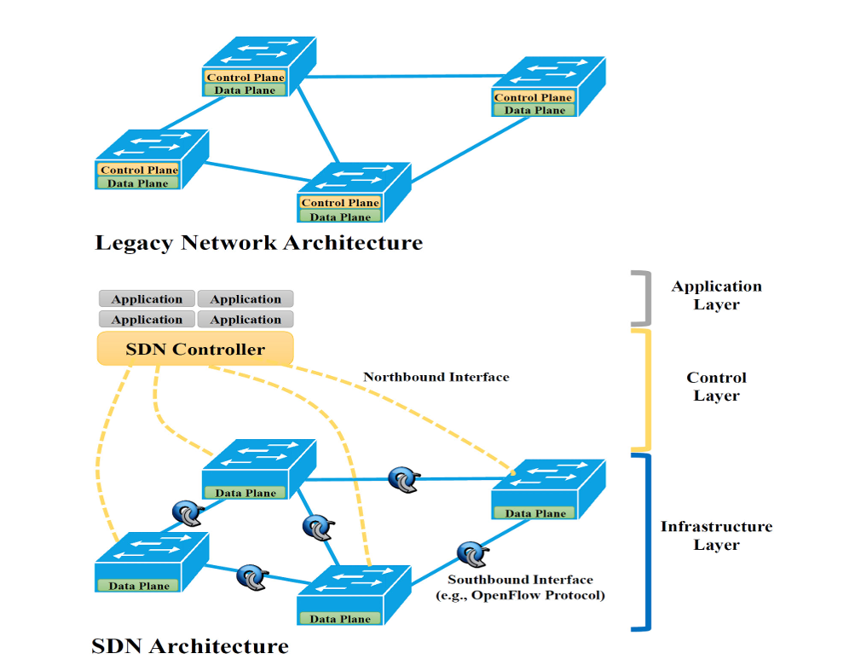
SDN Architecture

Slide 7
COMPARISION WITH EXISTING MODELS

Slide 8
BENEFITS

Slide 9
BENEFITS

Slide 10
OBJECTIVES

Slide 11
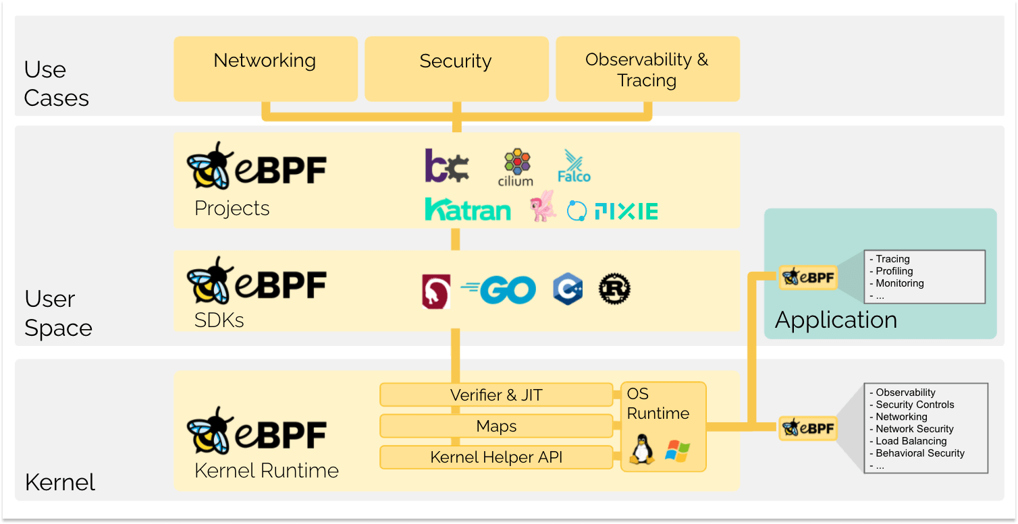
eBPF

Slide 12
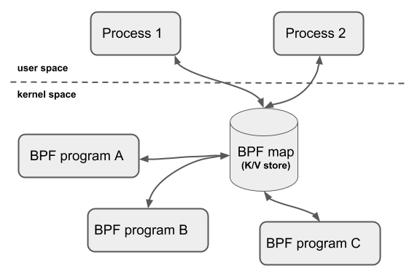
BPF Map

Slide 13
REFERENCES
IEEE Papers:

Slide 14


THANK YOU

